Slide 1

Intelligent Interfaces “Taboo Project”
An NLP-based guessing game inspired by the game Taboo and the Taboo challenge
Presented by:
Wouter Parys
Wissam Nasser
Charlotte Waltregny
16/06/2020

Slide 2
1 INCEPTION
The idea
Notes:
Motivated by 2 current social movements

Slide 3
Project Idea
INCEPTION
“Is it possible to use current AI technology for the identification of plant-based diseases? Furthermore, can we go beyond the diagnosis and aide in the plant care and remediation task?”
Notes:
To answer these questions with thesis :
Accurate & Fast detection of plant disease
Leads to remediation
→ In form of PoC

Slide 4
Requirements
Reliability
Performance
Supportability
Usability
Notes:
Reliability: Robust architecture, fault tolerant
Supportability & Performance: Externalising
1. Improve over time
2. external processing
Usability: Mobile App

Slide 5
2 SOLUTION ARCHITECTURE
Architectural Challenges
Notes:
Describes main infrastructure that the solution is based on

Slide 6

Solution Architecture Final
ACTORS
SYSTEMS
Knowledge Base
A knowledge table for Plant Deficiency
(and Remedy)
Knowledge Provider
Project Scope
AIDE
AI Diagnosis Engine
An AI-based Disease Diagnosis engine
End User
PlantCare
Mobile App
App for caring for domestic plants
PlantCare
Realtime Database
For storage of app data
Notes:
2 main parts: actor systems

Slide 7
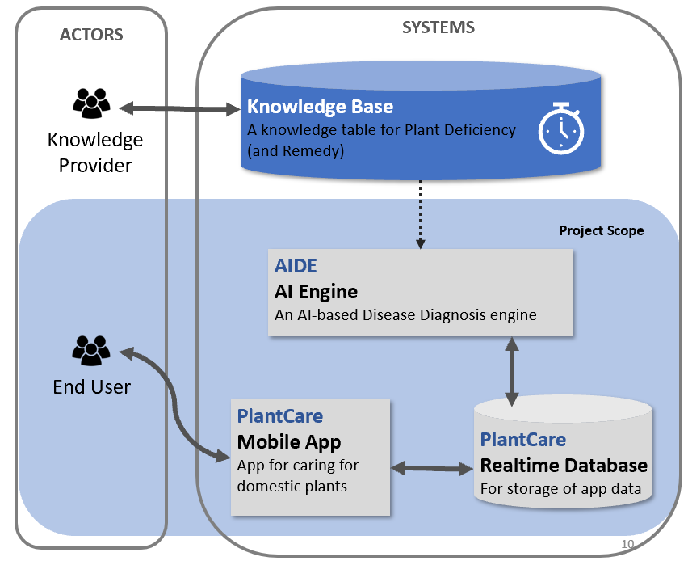
Solution Architecture Knowledge Base
Remedy & Disease Data
Out of scope

Slide 8
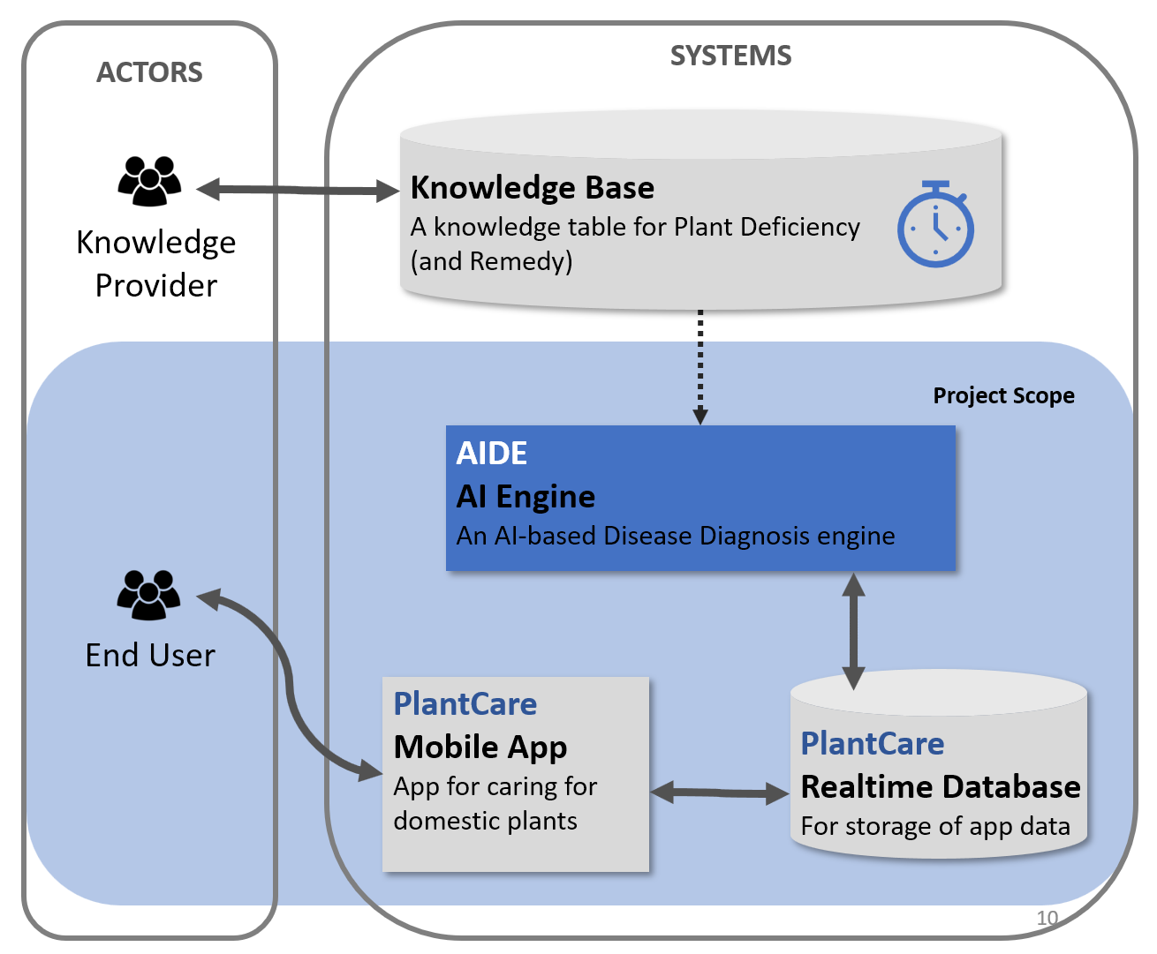
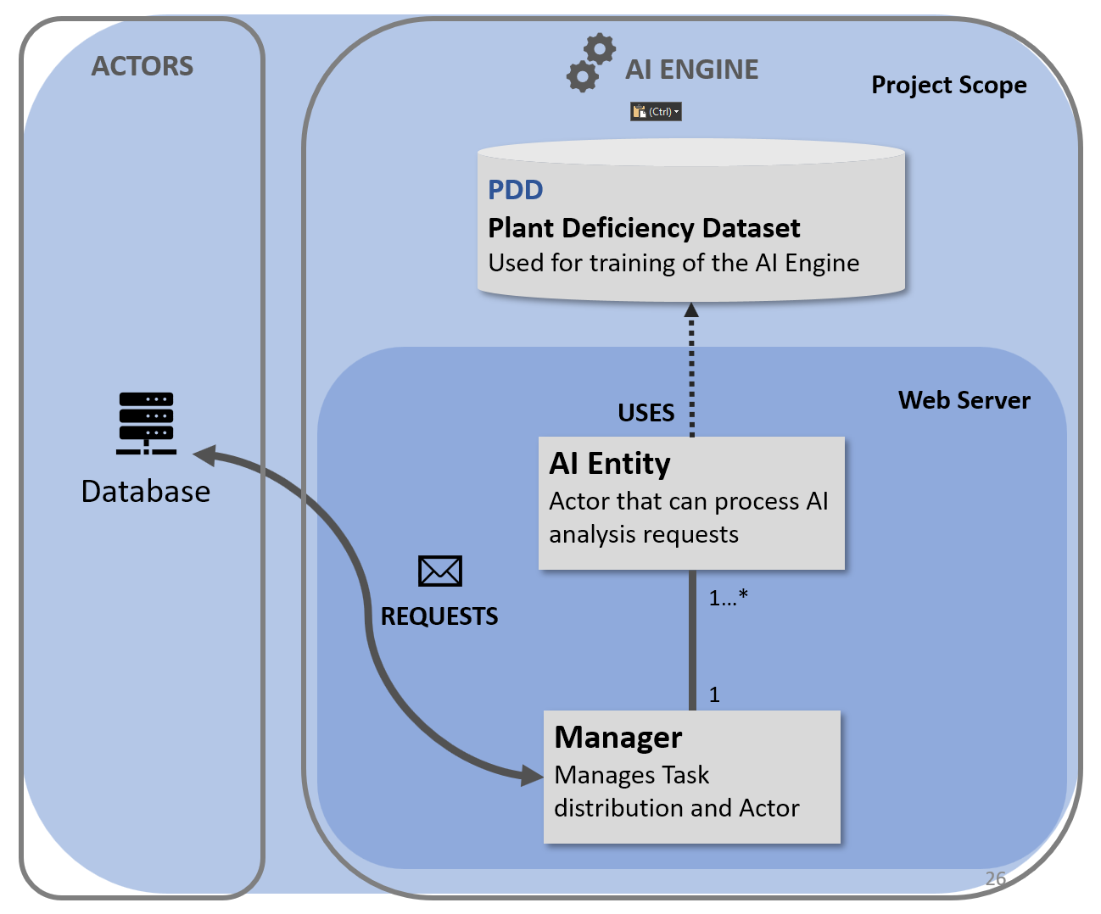
Solution Architecture AIDE AI Engine

Slide 9



Solution Architecture Plant Deficiency Dataset
Project Scope
ACTORS
AI ENGINE
PDD
Plant Deficiency Dataset
Used for training of the AI Engine
Web Server
USES
AI Entity
Actor that can process AI analysis requests
Database
REQUESTS
Manager
Manages Task distribution and Actor

Slide 10
Solution Architecture Actor Model
Project Scope
ACTORS
AI ENGINE
PDD
Plant Deficiency Dataset
Used for training of the AI Engine
Web Server
USES
AI Entity
Actor that can process AI analysis requests
Database
ACTOR MODEL
REQUESTS
ASYNC
CONCURENT
SCALABALE
FAULT TOLLERENT
Manager
Manages Task distribution and Actor

Slide 11
Solution Architecture Mobile
ACTORS
SYSTEMS
Knowledge Base
A knowledge table for Plant Deficiency
(and Remedy)
Knowledge Provider
Project Scope
AIDE
AI Engine
An AI-based Disease Diagnosis engine
End User
PlantCare
Mobile App
App for caring for domestic plants
PlantCare
Realtime Database
For storage of app data

Slide 12

Solution Architecture Database
ACTORS
SYSTEMS
Knowledge Base
A knowledge table for Plant Deficiency
(and Remedy)
Knowledge Provider
Project Scope
AIDE
AI Engine
An AI-based Disease Diagnosis engine
End User
PlantCare
Mobile App
App for caring for domestic plants
PlantCare
Realtime Database
For storage of app data

Slide 13









Why Firebase?
Project Scope
SYSTEMS
AI Engine
REST API
Any View
Mobile App, Web App, Desktop App, ...
Realtime Database

Slide 14
3 AI ASPECTS
AI Challenges

Slide 15
AI Challenges
Analysis
Accuracy
Usability

Slide 16

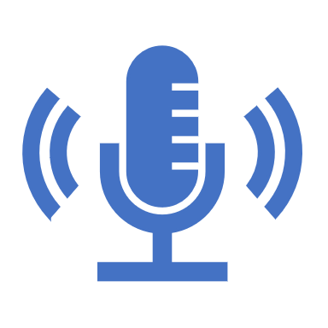
Analysis
Google Speech to Text
→ For input of description
Own NLP Model
→ For text classification
Training Data
→ Zoo dataset & wiki data

Slide 17

Accuracy
Relative top-1 accuracy of XX%
→ Continuesly improving system
Notes:
Verification System:
Up to 3 classifcations to compare symptoms with his own plant.
Retry System:
When user takes picture of plant type , if plant type not found in th top-3 classifications, image is re-evaluated by AI model. If still not in top-3, user is asked to take another picture

Slide 18

Usability
Intuitive Integration
→ Desktop app

Slide 19
Functional Scalability
User plays game and generates new descriptions
Add new labelled descriptions to DB
AI Training with data

Slide 20
Thank you for listening
Intelligent Interfaces
Wouter Parys
Wissam Nasser
Charlotte Waltregny
2019-2020

